Slide 1
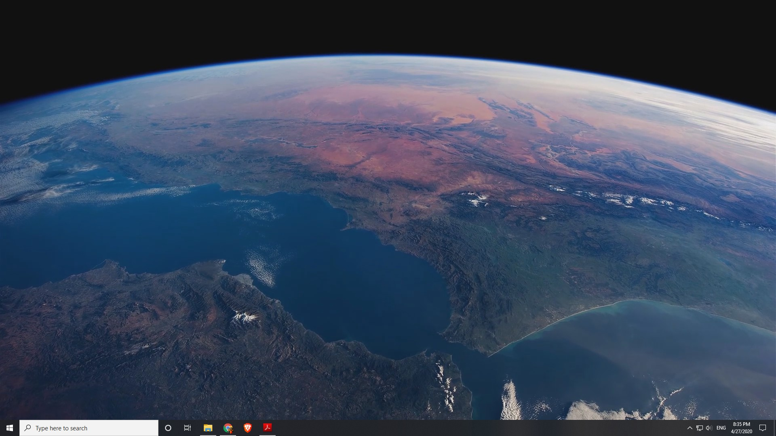
Socket Programing
Workshop | Montana Esguerra

Slide 2

Follow Along!
Clone my repo:
https://github.com/mje349/Web-Server.git
Please use Python 3.x
“You don’t need to be an expert, you just need to know enough to do a good job!”
-Wise Person

Slide 3

Creating Network Applications
Typically, network applications consist of a pair of programs:
Client Program
Server Program
When executed, a client process and a server process are created and these two processes communicate through sockets.
When creating a network application, our main task is to write code for both the client and the server

Slide 4
Network Applications
There are Two Types!
Open
Operation is specified in a protocol standard such as an RFC (Request For Comments)
Ex. HTTP
Proprietary
The client and server programs use a protocol that has not been openly published in an RFC or elsewhere
Ex. Skype

Slide 5
TCP vs UDP
TCP
Connection oriented
Provides a reliable byte stream channel
Ex: email, http (websites)
UDP
Connectionless
Sends independent packets with no guarantees about delivery
Ex: voice over IP (VoIP), Streaming

Slide 6
Socket Parameters
Example.
clientSocket = socket(AF_INET, SOCK_STREAM)
1st parameter is the address family
AF_INET = IPv4
AF_INET6 = IPv6
AF_UNIX = UNIX domain sockets
2nd parameter is the socket type
SOCK_STREAM = TCP
SOCK_DGRAM = UDP

Slide 7
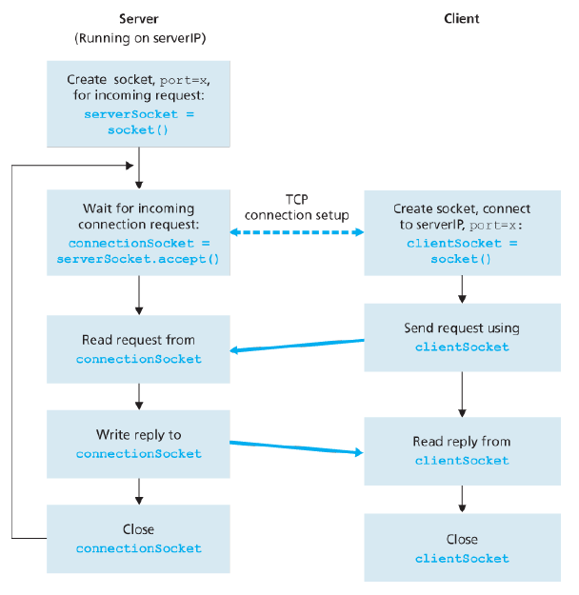
Client-Server application using TCP

Slide 8
DEMO
Time to see some code!

Slide 9
THANK YOU!
Email: mje349@nyu.edu

